Slide 1
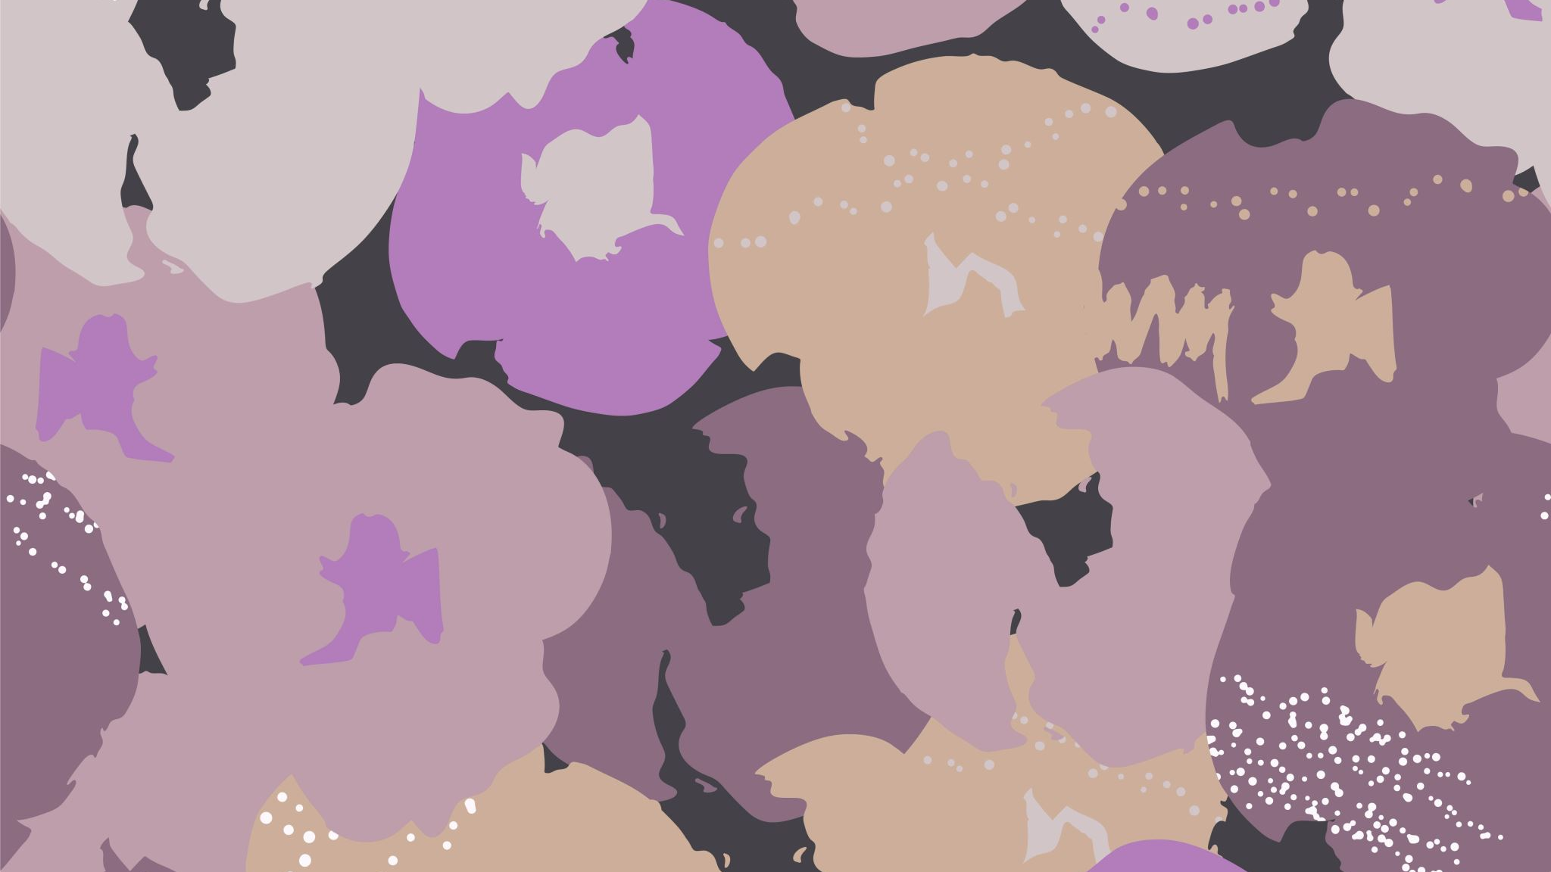
For: Vegans moving to toronto
A cluster analysis of vegan places in toronto

Slide 2
Restrictions are tough
Vegan dietary restriction means missing out on your favorite foods
Desserts – have egg
Non vegan ingredients like dairy and milk

Slide 3
A person moving to Toronto who is vegan..
.. Will sure doubt need a neighborhood with a few vegan places near by
Within walking distance
Recognized as Vegan by FourSquare

Slide 4
Our Process

Slide 5
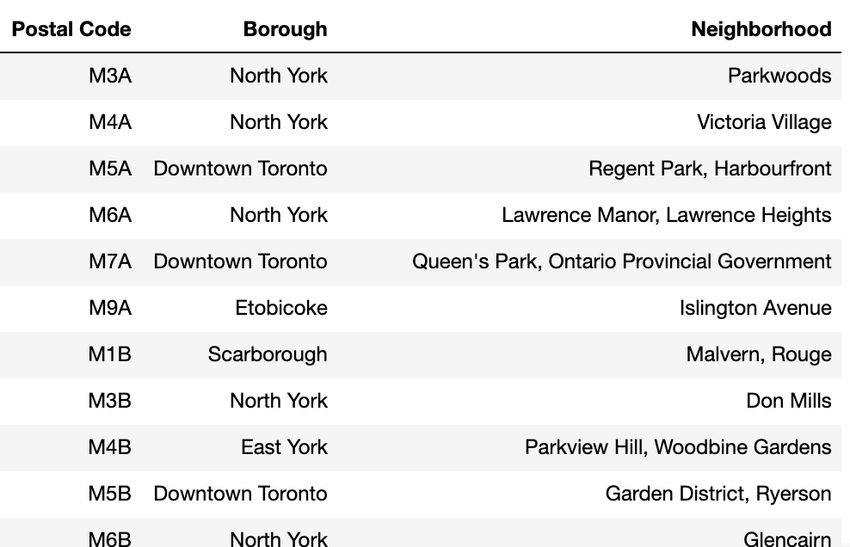
Importing the neighborhoods
We scrapped Wikipedia for the list of neighborhoods and then cleaned it as seen below

Slide 6
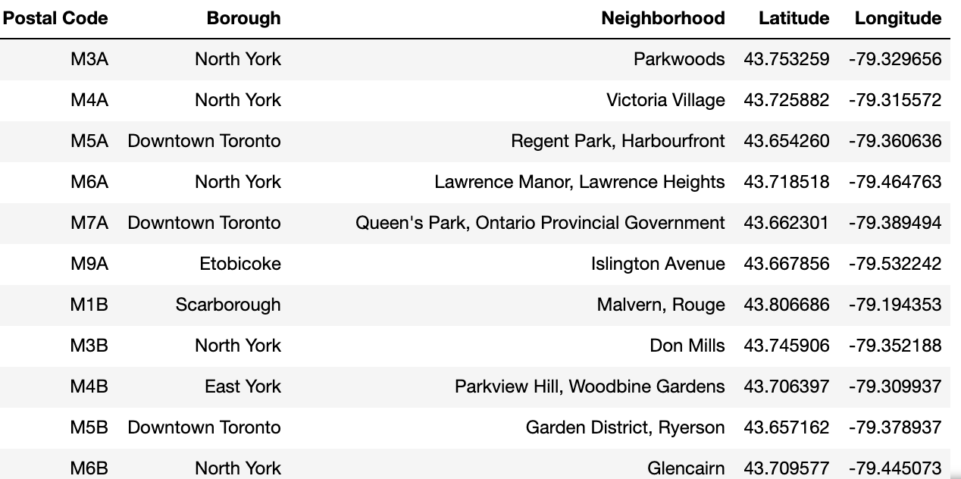
Geocoding the neighborhoods
We then added geocoding search from google to get latitude and longitude

Slide 7
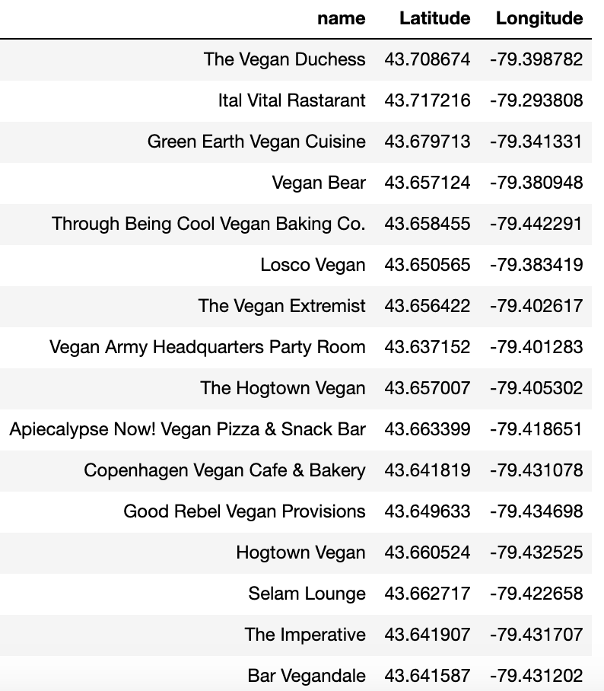
Running proximity searches on Four Square
We set restrictions on distance (within walking distance)
And searched for Vegan
We compiled a list of unique elements

Slide 8
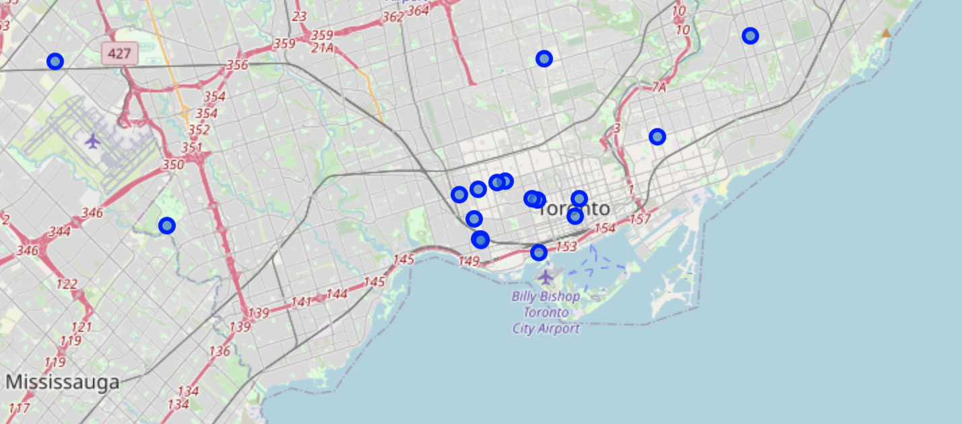
Restaurants on maps
We mapped the results

Slide 9
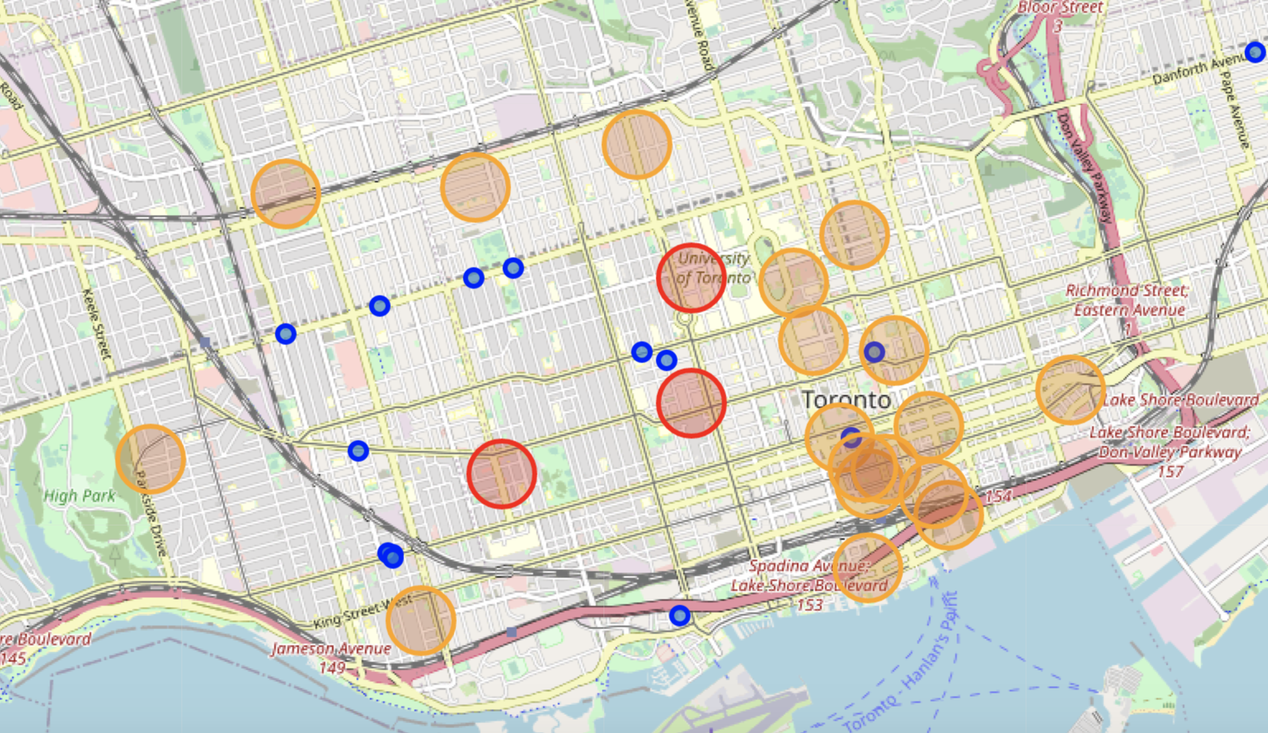
Then we identified which neighborhoods were most Vegan
We did an analysis to see which neighborhoods had a high density of vegan places, and then placed them on a map

Slide 10
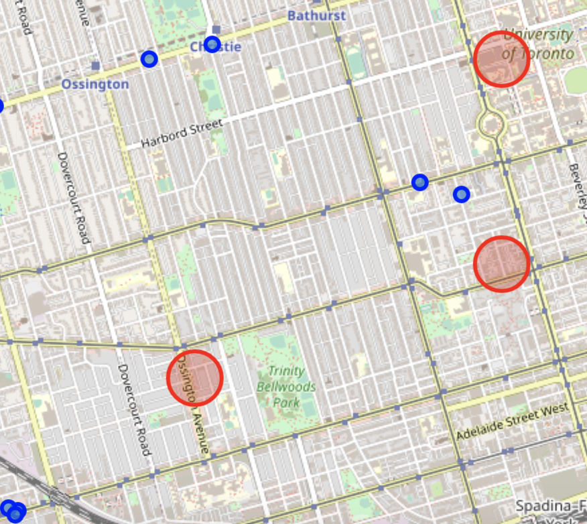
Conclusion: Where I’d stay
If I had to pick, I would stay here: based on the walking distance proximity to different vegan food options

Slide 11
Thank you.

